Slide 1
Building Java Programs Chapter 1
Introduction to Java Programming
Copyright (c) Pearson 2013. All rights reserved.

Slide 2
What is computer science?
Computer Science
The study of theoretical foundations of information and computation and their implementation and application in computer systems. -- Wikipedia
Many subfields
Graphics, Computer Vision
Artificial Intelligence
Scientific Computing
Robotics
Databases, Data Mining
Computational Linguistics, Natural Language Processing ...
Computer Engineering
Overlap with CS and EE; emphasizes hardware

Slide 3
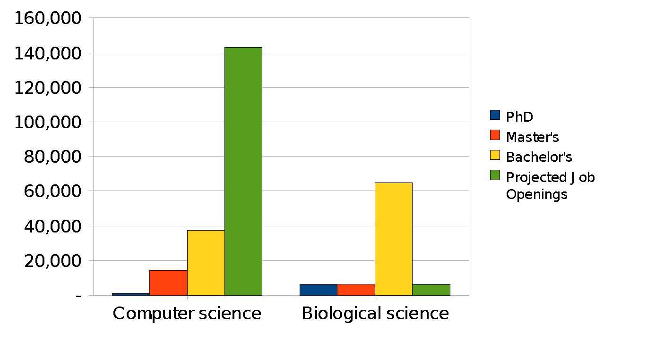
The CS job market
SOURCES: Tabulated by National Science Foundation/Division of Science Resources Statistics; data from Department of Education/National Center for Education Statistics: Integrated Postsecondary Education Data System Completions Survey; and NSF/SRS: Sur

Slide 4

What is programming?
program: A set of instructions to be carried out by a computer.
program execution: The act of carrying out the instructions contained in a program.
programming language: A systematic set of rules used to describe computations in a format that is editable by humans.
This textbook teaches programming in a language named Java.

Slide 5
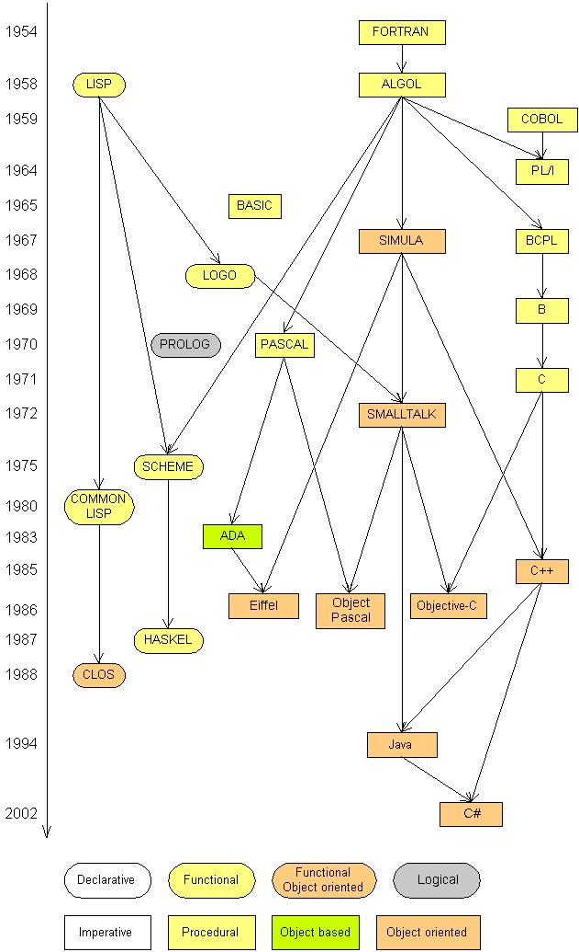
Programming languages
Some influential ones:
FORTRAN
science / engineering
COBOL
business data
LISP
logic and AI
BASIC
a simple language

Slide 6
Some modern languages
procedural languages: programs are a series of commands
Pascal (1970): designed for education
C (1972): low-level operating systems and device drivers
functional programming: functions map inputs to outputs
Lisp (1958) / Scheme (1975), ML (1973), Haskell (1990)
object-oriented languages: programs use interacting "objects"
Smalltalk (1980): first major object-oriented language
C++ (1985): "object-oriented" improvements to C
successful in industry; used to build major OSes such as Windows
Java (1995): designed for embedded systems, web apps/servers
Runs on many platforms (Windows, Mac, Linux, cell phones...)
The language taught in this textbook

Slide 7
Basic Java programs with println statements

Slide 8



Compile/run a program
Write it.
code or source code: The set of instructions in a program.
Compile it.
compile: Translate a program from one language to another.
byte code: The Java compiler converts your code into a format named byte code that runs on many computer types.
Run (execute) it.
output: The messages printed to the user by a program.
source code
byte code
output
compile
run

Slide 9
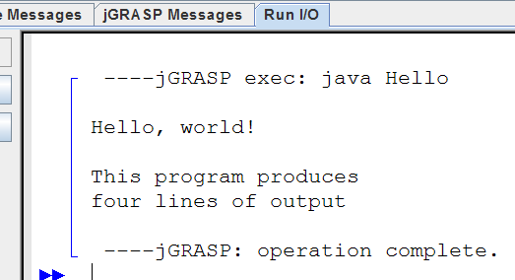
A Java program
public class Hello {
public static void main(String[] args) {
System.out.println("Hello, world!");
System.out.println();
System.out.println("This program produces");
System.out.println("four lines of output");
}
}
Its output:
Hello, world!
This program produces
four lines of output
console: Text box into which the program's output is printed.

Slide 10
Structure of a Java program
class: a program
public class name {
public static void main(String[] args) {
statement;
statement;
...
statement;
}
}
Every executable Java program consists of a class,
that contains a method named main,
that contains the statements (commands) to be executed.
method: a named group of statements
statement: a command to be executed

Slide 11
System.out.println
A statement that prints a line of output on the console.
pronounced "print-linn"
sometimes called a "println statement" for short
Two ways to use System.out.println :
System.out.println("text");
Prints the given message as output.
System.out.println();
Prints a blank line of output.

Slide 12
Names and identifiers
You must give your program a name.
public class GangstaRap {
Naming convention: capitalize each word (e.g. MyClassName)
Your program's file must match exactly (GangstaRap.java)
includes capitalization (Java is "case-sensitive")
identifier: A name given to an item in your program.
must start with a letter or _ or $
subsequent characters can be any of those or a number
legal: _myName TheCure ANSWER_IS_42 $bling$
illegal: me+u 49ers side-swipe Ph.D's

Slide 13
Keywords
keyword: An identifier that you cannot use because it already has a reserved meaning in Java.
abstract default if private this
boolean do implements protected throw
break double import public throws
byte else instanceof return transient
case extends int short try
catch final interface static void
char finally long strictfp volatile
class float native super while
const for new switch
continue goto package synchronized

Slide 14
Syntax
syntax: The set of legal structures and commands that can be used in a particular language.
Every basic Java statement ends with a semicolon ;
The contents of a class or method occur between { and }
syntax error (compiler error): A problem in the structure of a program that causes the compiler to fail.
Missing semicolon
Too many or too few { } braces
Illegal identifier for class name
Class and file names do not match
...

Slide 15
Syntax error example
1 public class Hello {
2 pooblic static void main(String[] args) {
3 System.owt.println("Hello, world!")_
4 }
5 }
Compiler output:
Hello.java:2: <identifier> expected
pooblic static void main(String[] args) {
^
Hello.java:3: ';' expected
}
^
2 errors
The compiler shows the line number where it found the error.
The error messages can be tough to understand!

Slide 16
Strings
string: A sequence of characters to be printed.
Starts and ends with a " quote " character.
The quotes do not appear in the output.
Examples: "hello" "This is a string. It's very long!"
Restrictions:
May not span multiple lines. "This is not a legal String."
May not contain a " character. "This is not a "legal" String either."

Slide 17
Escape sequences
escape sequence: A special sequence of characters used to represent certain special characters in a string.
\t tab character
\n new line character
\" quotation mark character
\\ backslash character
Example: System.out.println("\\hello\nhow\tare \"you\"?\\\\");
Output: \hello how are "you"?\\

Slide 18
Questions
What is the output of the following println statements?
System.out.println("\ta\tb\tc");
System.out.println("\\\\");
System.out.println("'");
System.out.println("\"\"\"");
System.out.println("C:\nin\the downward spiral");
Write a println statement to produce this output:
/ \ // \\ /// \\\

Slide 19
Answers
Output of each println statement:
a b c
\\
'
"""
C:
in he downward spiral
println statement to produce the line of output:
System.out.println("/ \\ // \\\\ /// \\\\\\");

Slide 20
Questions
What println statements will generate this output?
This program prints a
quote from the Gettysburg Address.
"Four score and seven years ago,
our 'fore fathers' brought forth on
this continent a new nation."
What println statements will generate this output?
A "quoted" String is
'much' better if you learn
the rules of "escape sequences."
Also, "" represents an empty String.
Don't forget: use \" instead of " !
'' is not the same as "

Slide 21
Answers
println statements to generate the output:
System.out.println("This program prints a");
System.out.println("quote from the Gettysburg Address.");
System.out.println();
System.out.println("\"Four score and seven years ago,");
System.out.println("our 'fore fathers' brought forth on");
System.out.println("this continent a new nation.\"");
println statements to generate the output:
System.out.println("A \"quoted\" String is");
System.out.println("'much' better if you learn");
System.out.println("the rules of \"escape sequences.\"");
System.out.println();
System.out.println("Also, \"\" represents an empty String.");
System.out.println("Don't forget: use \\\" instead of \" !");
System.out.println("'' is not the same as \"");

Slide 22
Comments
comment: A note written in source code by the programmer to describe or clarify the code.
Comments are not executed when your program runs.
Syntax:
// comment text, on one line or, /* comment text; may span multiple lines */
Examples:
// This is a one-line comment.
/* This is a very long
multi-line comment. */

Slide 23
Using comments
Where to place comments:
at the top of each file (a "comment header")
at the start of every method (seen later)
to explain complex pieces of code
Comments are useful for:
Understanding larger, more complex programs.
Multiple programmers working together, who must understand each other's code.

Slide 24
Comments example
/* Suzy Student, CS 101, Fall 2019
This program prints lyrics about ... something. */
public class BaWitDaBa {
public static void main(String[] args) {
// first verse
System.out.println("Bawitdaba");
System.out.println("da bang a dang diggy diggy");
System.out.println();
// second verse
System.out.println("diggy said the boogy");
System.out.println("said up jump the boogy");
}
}

Slide 25
Static methods

Slide 26
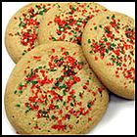
Algorithms
algorithm: A list of steps for solving a problem.
Example algorithm: "Bake sugar cookies"
Mix the dry ingredients.
Cream the butter and sugar.
Beat in the eggs.
Stir in the dry ingredients.
Set the oven temperature.
Set the timer.
Place the cookies into the oven.
Allow the cookies to bake.
Spread frosting and sprinkles onto the cookies.
...

Slide 27
Problems with algorithms
lack of structure: Many tiny steps; tough to remember.
redundancy: Consider making a double batch...
Mix the dry ingredients.
Cream the butter and sugar.
Beat in the eggs.
Stir in the dry ingredients.
Set the oven temperature.
Set the timer.
Place the first batch of cookies into the oven.
Allow the cookies to bake.
Set the timer.
Place the second batch of cookies into the oven.
Allow the cookies to bake.
Mix ingredients for frosting.
...

Slide 28
Structured algorithms
structured algorithm: Split into coherent tasks.
1 Make the cookie batter.
Mix the dry ingredients.
Cream the butter and sugar.
Beat in the eggs.
Stir in the dry ingredients.
2 Bake the cookies.
Set the oven temperature.
Set the timer.
Place the cookies into the oven.
Allow the cookies to bake.
3 Add frosting and sprinkles.
Mix the ingredients for the frosting.
Spread frosting and sprinkles onto the cookies.
...

Slide 29
Removing redundancy
A well-structured algorithm can describe repeated tasks with less redundancy.
1 Make the cookie batter.
Mix the dry ingredients.
...
2a Bake the cookies (first batch).
Set the oven temperature.
Set the timer.
...
2b Bake the cookies (second batch).
3 Decorate the cookies.
...

Slide 30
A program with redundancy
public class BakeCookies {
public static void main(String[] args) {
System.out.println("Mix the dry ingredients.");
System.out.println("Cream the butter and sugar.");
System.out.println("Beat in the eggs.");
System.out.println("Stir in the dry ingredients.");
System.out.println("Set the oven temperature.");
System.out.println("Set the timer.");
System.out.println("Place a batch of cookies into the oven.");
System.out.println("Allow the cookies to bake.");
System.out.println("Set the oven temperature.");
System.out.println("Set the timer.");
System.out.println("Place a batch of cookies into the oven.");
System.out.println("Allow the cookies to bake.");
System.out.println("Mix ingredients for frosting.");
System.out.println("Spread frosting and sprinkles.");
}
}

Slide 31
Static methods
static method: A named group of statements.
denotes the structure of a program
eliminates redundancy by code reuse
procedural decomposition: dividing a problem into methods
Writing a static method is like adding a new command to Java.
class
method A
statement
statement
statement
method B
statement
statement
method C
statement
statement
statement

Slide 32
Using static methods
1. Design the algorithm.
Look at the structure, and which commands are repeated.
Decide what are the important overall tasks.
2. Declare (write down) the methods.
Arrange statements into groups and give each group a name.
3. Call (run) the methods.
The program's main method executes the other methods to perform the overall task.

Slide 33
Design of an algorithm
// This program displays a delicious recipe for baking cookies.
public class BakeCookies2 {
public static void main(String[] args) {
// Step 1: Make the cake batter.
System.out.println("Mix the dry ingredients.");
System.out.println("Cream the butter and sugar.");
System.out.println("Beat in the eggs.");
System.out.println("Stir in the dry ingredients.");
// Step 2a: Bake cookies (first batch).
System.out.println("Set the oven temperature.");
System.out.println("Set the timer.");
System.out.println("Place a batch of cookies into the oven.");
System.out.println("Allow the cookies to bake.");
// Step 2b: Bake cookies (second batch).
System.out.println("Set the oven temperature.");
System.out.println("Set the timer.");
System.out.println("Place a batch of cookies into the oven.");
System.out.println("Allow the cookies to bake.");
// Step 3: Decorate the cookies.
System.out.println("Mix ingredients for frosting.");
System.out.println("Spread frosting and sprinkles.");
}
}

Slide 34
Declaring a method
Gives your method a name so it can be executed
Syntax: public static void name() { statement; statement; ... statement; }
Example: public static void printWarning() { System.out.println("This product causes cancer"); System.out.println("in lab rats and humans."); }

Slide 35
Calling a method
Executes the method's code
Syntax:
name();
You can call the same method many times if you like.
Example:
printWarning();
Output:
This product causes cancer
in lab rats and humans.

Slide 36
Program with static method
public class FreshPrince {
public static void main(String[] args) {
rap(); // Calling (running) the rap method
System.out.println();
rap(); // Calling the rap method again
}
// This method prints the lyrics to my favorite song.
public static void rap() {
System.out.println("Now this is the story all about how");
System.out.println("My life got flipped turned upside-down");
}
}
Output:
Now this is the story all about how
My life got flipped turned upside-down
Now this is the story all about how
My life got flipped turned upside-down

Slide 37
Final cookie program
// This program displays a delicious recipe for baking cookies.
public class BakeCookies3 {
public static void main(String[] args) {
makeBatter();
bake(); // 1st batch
bake(); // 2nd batch
decorate();
}
// Step 1: Make the cake batter.
public static void makeBatter() {
System.out.println("Mix the dry ingredients.");
System.out.println("Cream the butter and sugar.");
System.out.println("Beat in the eggs.");
System.out.println("Stir in the dry ingredients.");
}
// Step 2: Bake a batch of cookies.
public static void bake() {
System.out.println("Set the oven temperature.");
System.out.println("Set the timer.");
System.out.println("Place a batch of cookies into the oven.");
System.out.println("Allow the cookies to bake.");
}
// Step 3: Decorate the cookies.
public static void decorate() {
System.out.println("Mix ingredients for frosting.");
System.out.println("Spread frosting and sprinkles.");
}
}

Slide 38
Methods calling methods
public class MethodsExample {
public static void main(String[] args) {
message1();
message2();
System.out.println("Done with main.");
}
public static void message1() {
System.out.println("This is message1.");
}
public static void message2() {
System.out.println("This is message2.");
message1();
System.out.println("Done with message2.");
}
}
Output:
This is message1.
This is message2.
This is message1.
Done with message2.
Done with main.

Slide 39
Control flow
When a method is called, the program's execution...
"jumps" into that method, executing its statements, then
"jumps" back to the point where the method was called.
public class MethodsExample {
public static void main(String[] args) {
message1();
message2();
System.out.println("Done with main.");
}
...
}
public static void message1() {
System.out.println("This is message1.");
}
public static void message2() {
System.out.println("This is message2.");
message1();
System.out.println("Done with message2.");
}
public static void message1() {
System.out.println("This is message1.");
}

Slide 40
When to use methods
Place statements into a static method if:
The statements are related structurally, and/or
The statements are repeated.
You should not create static methods for:
An individual println statement.
Only blank lines. (Put blank printlns in main.)
Unrelated or weakly related statements. (Consider splitting them into two smaller methods.)

Slide 41
Drawing complex figures with static methods

Slide 42
Static methods question
Write a program to print these figures using methods.
______
/ \
/ \
\ /
\______/
\ /
\______/
+--------+
______
/ \
/ \
| STOP |
\ /
\______/
______
/ \
/ \
+--------+

Slide 43
Development strategy
______
/ \
/ \
\ /
\______/
\ /
\______/
+--------+
______
/ \
/ \
| STOP |
\ /
\______/
______
/ \
/ \
+--------+
First version (unstructured):
Create an empty program and main method.
Copy the expected output into it, surrounding each line with System.out.println syntax.
Run it to verify the output.

Slide 44
Program version 1
public class Figures1 {
public static void main(String[] args) {
System.out.println(" ______");
System.out.println(" / \\");
System.out.println("/ \\");
System.out.println("\\ /");
System.out.println(" \\______/");
System.out.println();
System.out.println("\\ /");
System.out.println(" \\______/");
System.out.println("+--------+");
System.out.println();
System.out.println(" ______");
System.out.println(" / \\");
System.out.println("/ \\");
System.out.println("| STOP |");
System.out.println("\\ /");
System.out.println(" \\______/");
System.out.println();
System.out.println(" ______");
System.out.println(" / \\");
System.out.println("/ \\");
System.out.println("+--------+");
}
}

Slide 45
Development strategy 2
______
/ \
/ \
\ /
\______/
\ /
\______/
+--------+
______
/ \
/ \
| STOP |
\ /
\______/
______
/ \
/ \
+--------+
Second version (structured, with redundancy):
Identify the structure of the output.
Divide the main method into static methods based on this structure.

Slide 46
Output structure
______
/ \
/ \
\ /
\______/
\ /
\______/
+--------+
______
/ \
/ \
| STOP |
\ /
\______/
______
/ \
/ \
+--------+
The structure of the output:
initial "egg" figure
second "teacup" figure
third "stop sign" figure
fourth "hat" figure
This structure can be represented by methods:
egg
teaCup
stopSign
hat

Slide 47
Program version 2
public class Figures2 {
public static void main(String[] args) {
egg();
teaCup();
stopSign();
hat();
}
public static void egg() {
System.out.println(" ______");
System.out.println(" / \\");
System.out.println("/ \\");
System.out.println("\\ /");
System.out.println(" \\______/");
System.out.println();
}
public static void teaCup() {
System.out.println("\\ /");
System.out.println(" \\______/");
System.out.println("+--------+");
System.out.println();
}
...

Slide 48
Program version 2, cont'd.
...
public static void stopSign() {
System.out.println(" ______");
System.out.println(" / \\");
System.out.println("/ \\");
System.out.println("| STOP |");
System.out.println("\\ /");
System.out.println(" \\______/");
System.out.println();
}
public static void hat() {
System.out.println(" ______");
System.out.println(" / \\");
System.out.println("/ \\");
System.out.println("+--------+");
}
}

Slide 49
Development strategy 3
______
/ \
/ \
\ /
\______/
\ /
\______/
+--------+
______
/ \
/ \
| STOP |
\ /
\______/
______
/ \
/ \
+--------+
Third version (structured, without redundancy):
Identify redundancy in the output, and create methods to eliminate as much as possible.
Add comments to the program.

Slide 50
Output redundancy
______
/ \
/ \
\ /
\______/
\ /
\______/
+--------+
______
/ \
/ \
| STOP |
\ /
\______/
______
/ \
/ \
+--------+
The redundancy in the output:
egg top: reused on stop sign, hat
egg bottom: reused on teacup, stop sign
divider line: used on teacup, hat
This redundancy can be fixed by methods:
eggTop
eggBottom
line

Slide 51
Program version 3
// Suzy Student, CSE 138, Spring 2094
// Prints several figures, with methods for structure and redundancy.
public class Figures3 {
public static void main(String[] args) {
egg();
teaCup();
stopSign();
hat();
}
// Draws the top half of an an egg figure.
public static void eggTop() {
System.out.println(" ______");
System.out.println(" / \\");
System.out.println("/ \\");
}
// Draws the bottom half of an egg figure.
public static void eggBottom() {
System.out.println("\\ /");
System.out.println(" \\______/");
}
// Draws a complete egg figure.
public static void egg() {
eggTop();
eggBottom();
System.out.println();
}
...

Slide 52
Program version 3, cont'd.
...
// Draws a teacup figure.
public static void teaCup() {
eggBottom();
line();
System.out.println();
}
// Draws a stop sign figure.
public static void stopSign() {
eggTop();
System.out.println("| STOP |");
eggBottom();
System.out.println();
}
// Draws a figure that looks sort of like a hat.
public static void hat() {
eggTop();
line();
}
// Draws a line of dashes.
public static void line() {
System.out.println("+--------+");
}
}

